Slide 1
DIPOLE MOMENTS

Slide 2
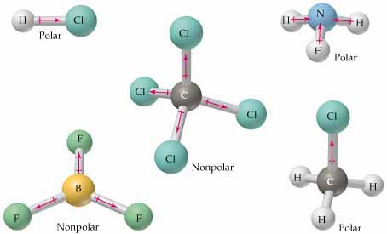
Dipole Moments
What are polar and nonpolar covalent bonds, and how are they formed?
Represents the atom’s polarity magnitude and direction (+ ➔ –)
Examples: H – Cl, NH₃, CH₃Cl, (& –COOH)

Slide 3
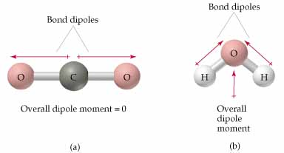
Dipole Moments
What are polar and nonpolar covalent bonds, and how are they formed?
Represents the atom’s polarity magnitude and direction (+ ➔ –)
Examples: H – Cl, NH₃, CH₃Cl, (& –COOH)
Water:

Slide 4
Dipole Moments
What are polar and nonpolar covalent bonds, and how are they formed?
Represents the atom’s polarity magnitude and direction (+ ➔ –)
Bond Polarity and Shape Matters:

Slide 5
Dipole Moments
What are polar and nonpolar covalent bonds, and how are they formed?
Represents the atom’s polarity magnitude and direction (+ ➔ –)
Bond Polarity and Shape Matters:

